Slide 1
Welcome to CSE 142B!
Miya Natsuhara
Spring 2022
We’re so excited you’re here!

Slide 2
Agenda
About us
What is Computer Science?
About this course
Learning objectives
Other similar courses
Course components
Our learning model
Tools and resources
Course Website
Ed
PollEverywhere
Discord
Assessment and grading
Collaboration
(Wed)

Slide 3
Agenda
About us
What is Computer Science?
About this course
Learning objectives
Other similar courses
Course components
Our learning model
Tools and resources
Course Website
Ed
PollEverywhere
Discord
Assessment and grading
Collaboration
(Wed)

Slide 4
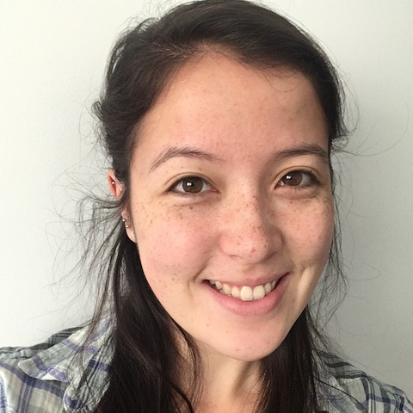
Hi, I’m Miya! (she/her)
Instructional Lecturer
Former Software Engineer at Microsoft
B.A. in Mathematics and B.S. in Computer Science, Masters degree in Computer Science from UW
Previously…
Frequent TA and Head TA for CSE 142
Lecturer for CSE 142

Slide 5
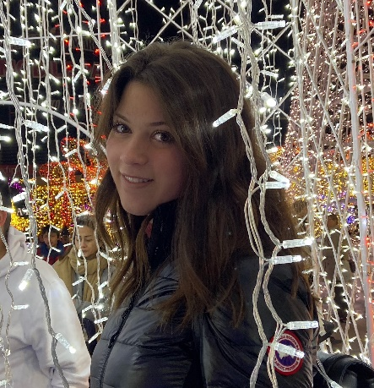
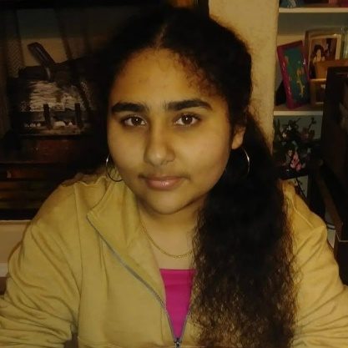
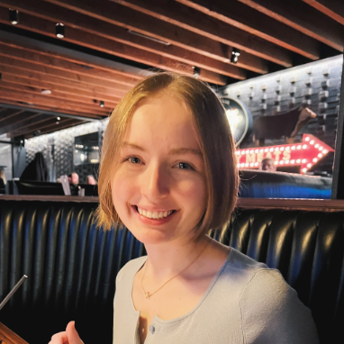
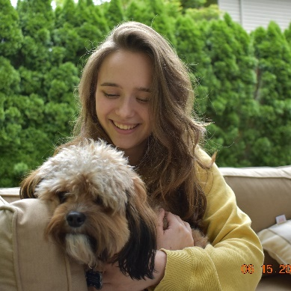
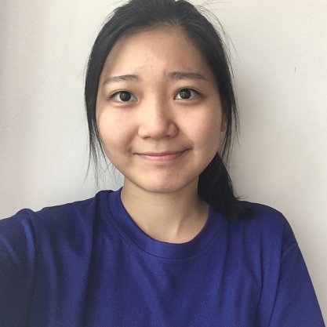
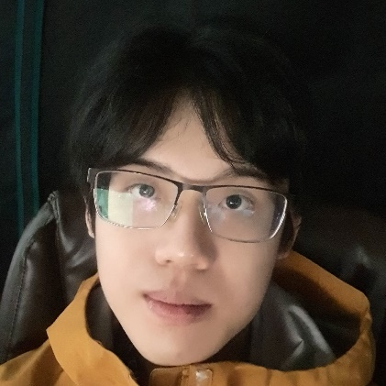
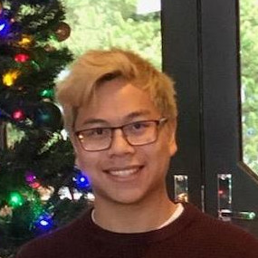
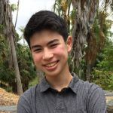
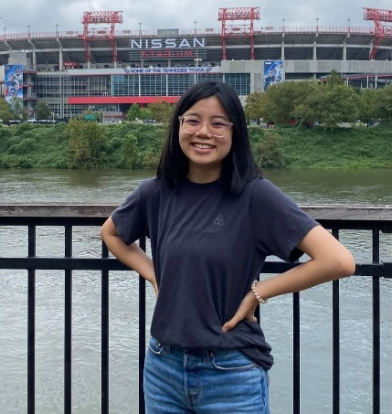
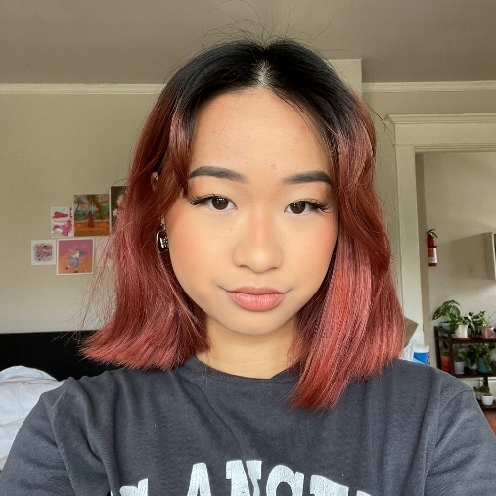
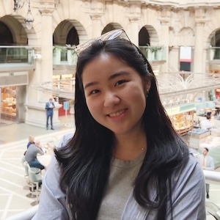
Meet your TAs
Notes:
UPDATE ME

Slide 6
Agenda
About us
What is Computer Science?
About this course
Learning objectives
Other similar courses
Course components
Our learning model
Tools and resources
Course Website
Ed
PollEverywhere
Discord
Assessment and grading
Collaboration
(Wed)

Slide 7
What is Computer Science?
Algorithm:
a step-by-step procedure for solving a problem or accomplishing some end especially by a computer
Programming is like
a building block
Computers?
Algorithmic Thinking
Science?

Slide 8
Agenda
About us
What is Computer Science?
About this course
Learning objectives
Other similar courses
Course components
Our learning model
Tools and resources
Course Website
Ed
PollEverywhere
Discord
Assessment and grading
Collaboration
(Wed)

Slide 9
CSE 142A vs. CSE 142B
Distinct courses with different course structures, instructors, and assessments
CSE 142A with Stuart Reges at 12:30pm
CSE142B with Miya Natsuhara (me!) at 8:30am
Not interchangeable – make sure you are paying attention to the course you are registered for!

Slide 10
Learning Objectives
or, “What will I learn in this class?”
Functionality/Behavior: Write functionally correct Java programs that meet a provided specification and/or solve a specified problem
Functional Decomposition: Break down problems into subproblems that are modular and reusable, and define methods to represent those subproblems
Control Structures: Select and apply control structures (e.g. methods, loops, conditionals) to manage the flow of control and information in programs
Data Abstraction: Select and apply basic data abstractions (e.g. variables, parameters, arrays, classes) to manage and manipulate data in programs
Code Quality: Define programs that are well-written, readable, maintainable, and conform to established standards

Slide 11
Other Similar Courses
Course | Good choice if…
CSE 142 | You’ve never programmed before OR You’ve done a little programming but feel rusty or not confident AND You are, or want to be, in a major such as CS, CE, EE, Info, etc. that requires Java programming
CSE 143 | You’ve programming in Java before OR You took AP CS A or IB CS in high school
CSE 143X | You’ve programmed a lot before in a language other than Java OR You are confident you can pick up new concepts very quickly OR You really, really need to get through two courses in one quarter
CSE 160 | You’ve never programmed before AND You’re interested in data science and analysis OR You’d rather learn Python than Java* OR You are, or want to be, in a major such as Physics, Bio, Stat, etc. where analyzing data through programming is useful

Slide 12
Course Components
Lessons (aka Lectures)
Sections
MWF, 8:30am PDT
Held live in person; recordings released after
First introductions to course concepts
Mix of presentation of content and practice activities/problems
Some required pre-work
Th, various times
Led by TAs
Held live in person; not recorded
Short videos will be released on occasion when important material is covered
Additional review, discussion, and practice
Mostly practice problems
Attendance is not taken, but you are responsible for all material (including announcements).

Slide 13
Course Components
Labs (optional)
T, various times
Problems released online, support from TAs in person
CSE 190 sections I through M and P through Q (pending confirmation)
1 credit course
Credit/No Credit grading

Slide 14
Agenda
About us
What is Computer Science?
About this course
Learning objectives
Other similar courses
Course components
Our learning model
Tools and resources
Course Website
Ed
PollEverywhere
Discord
Assessment and grading
Collaboration
(Wed)

Slide 16
Learning in CSE 142 (or anywhere)

Slide 17
Agenda
About us
What is Computer Science?
About this course
Learning objectives
Other similar courses
Course components
Our learning model
Tools and resources
Course Website
Ed
PollEverywhere
Discord
Assessment and grading
Collaboration
(Wed)

Slide 18
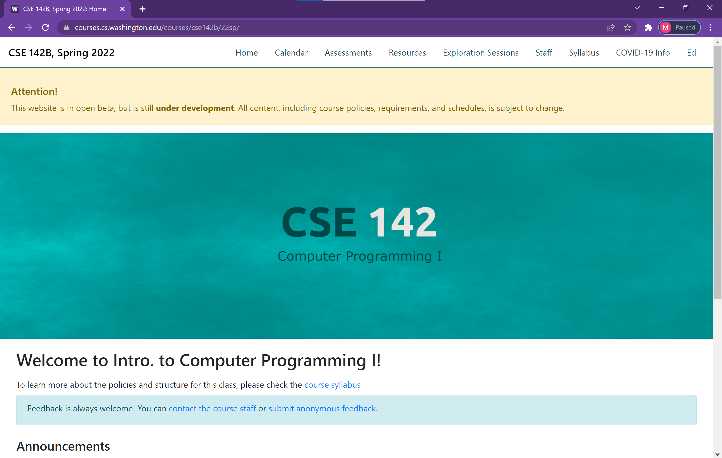
Course Website
cs.uw.edu/142b
Primary source of course information (not Canvas)
Calendar will contain links to (almost) all resources

Slide 19
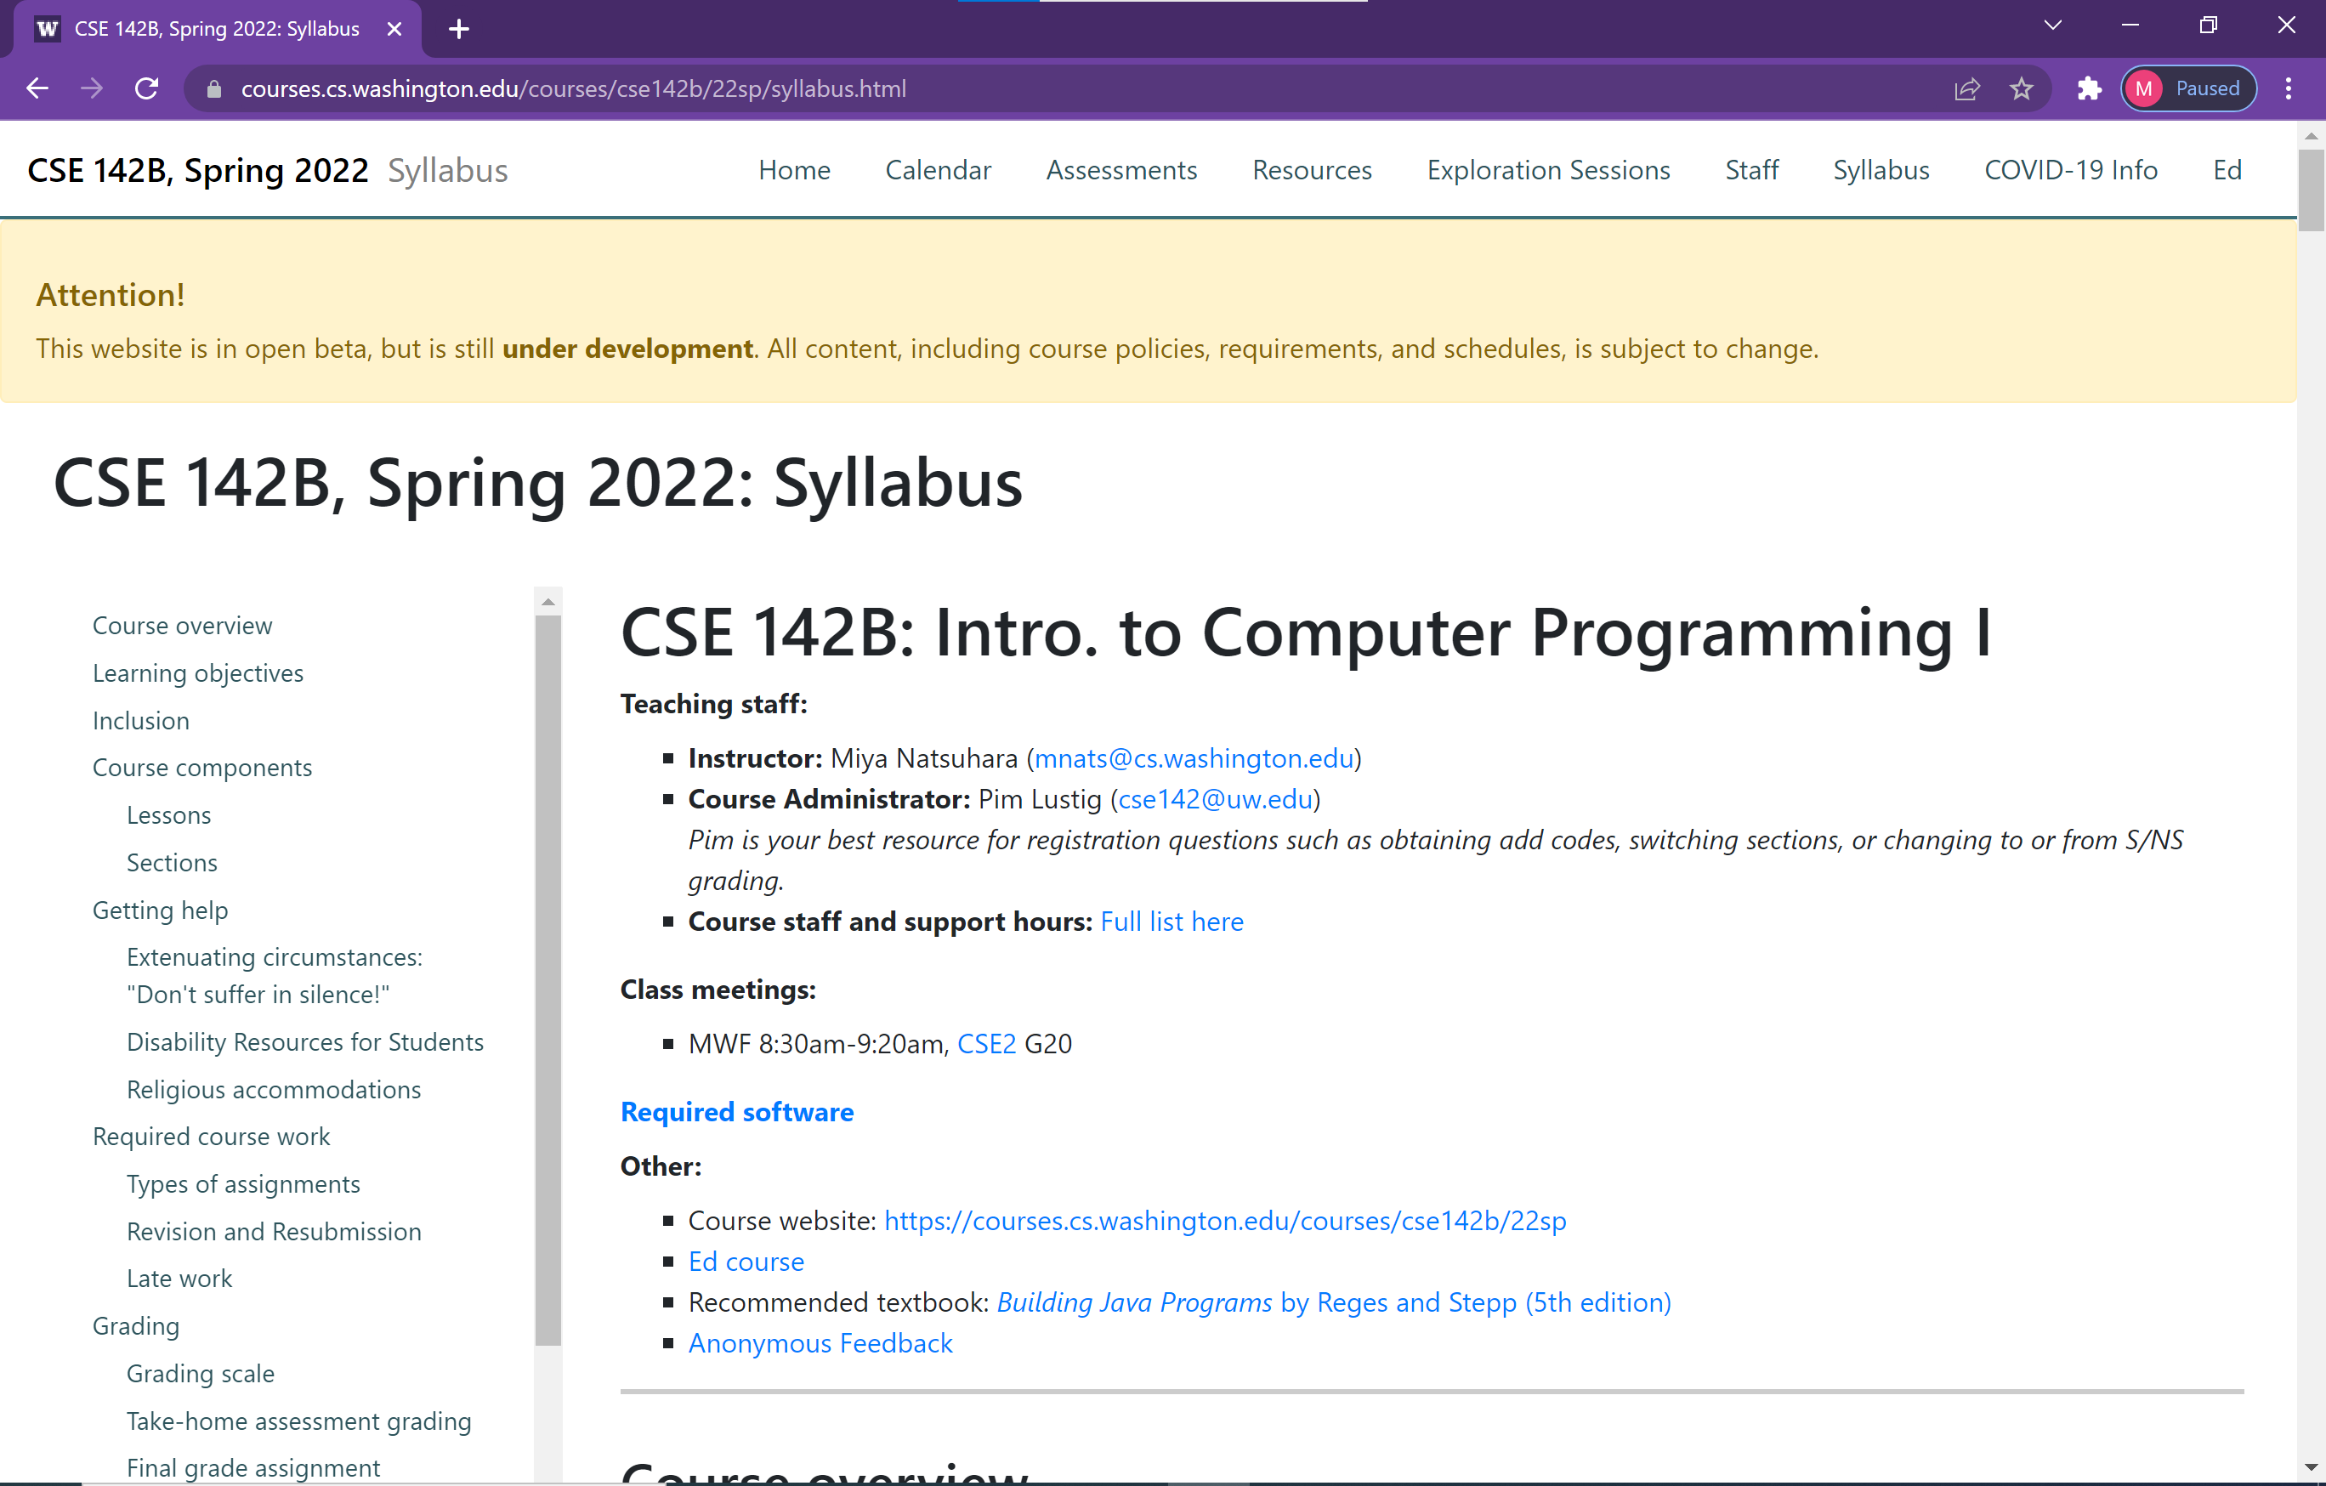
Course Website
Please review the syllabus ASAP.

Slide 20
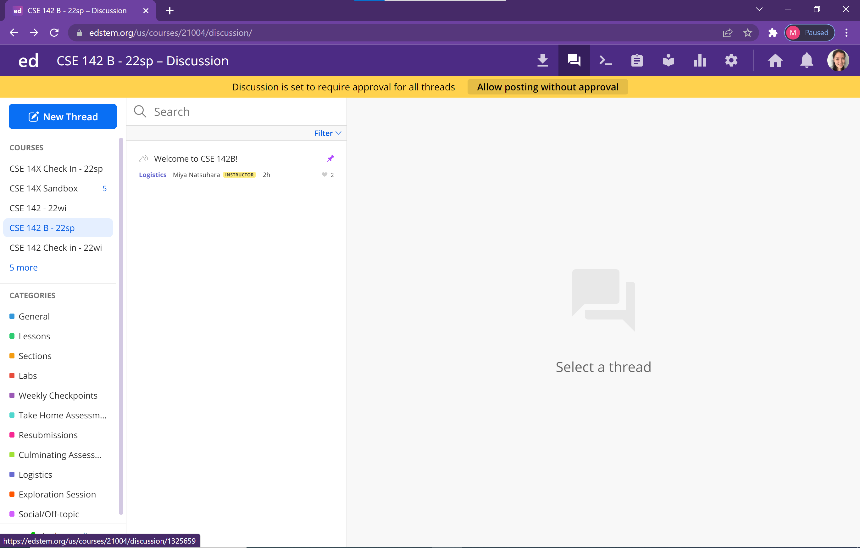
Ed
Our online learning platform
Lessons, sections, labs, assessments all here
Lecture Megathreads for each day that will be monitored by TAs during lecture
Intro and walkthrough video forthcoming

Slide 21
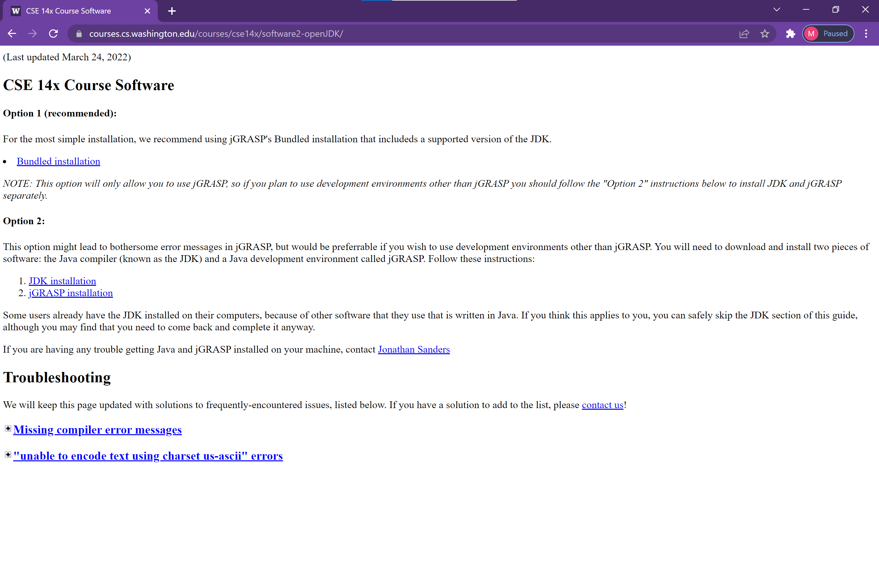
Software
You will need to install the JDK and jGRASP

Slide 22
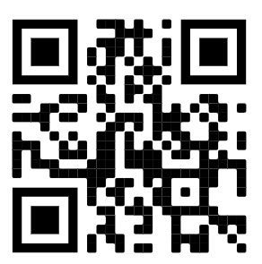
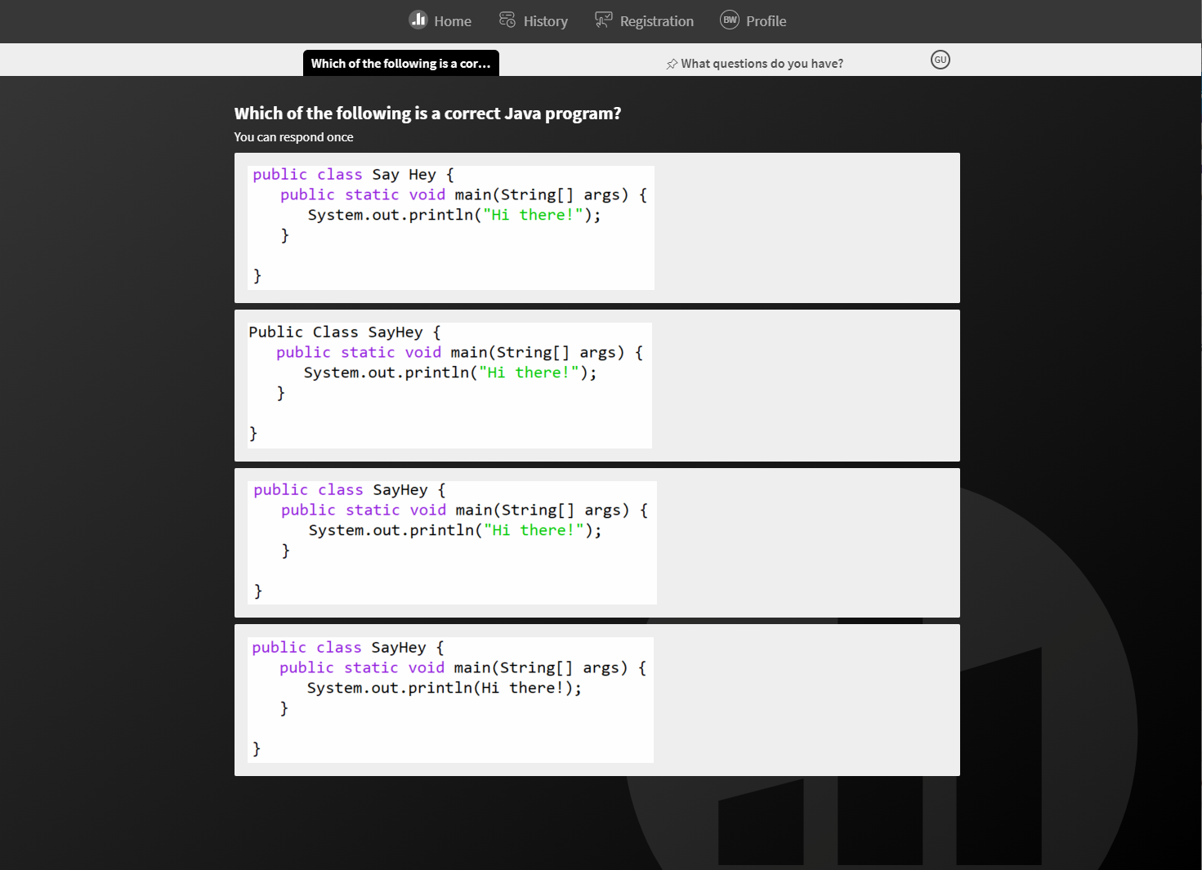
PollEverywhere
pollev.com/mnats
Two purposes (at least):
In-class activities
Short questions, problems, etc.
Usually multiple choice
Not graded
Not even on participation

Slide 23
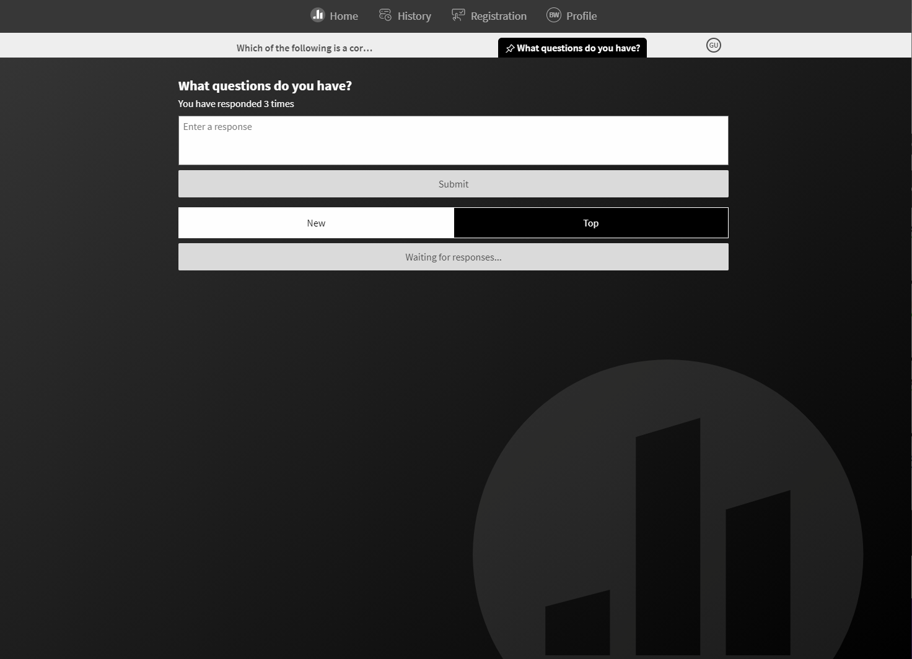
PollEverywhere
pollev.com/mnats
Two purposes (at least):
Questions backchannel
Ask questions at any time
I’ll check periodically and respond
Some may be deferred
Answers will be posted on Ed after class

Slide 24
Agenda
About us
What is Computer Science?
About this course
Learning objectives
Other similar courses
Course components
Our learning model
Tools and resources
Course Website
Ed
PollEverywhere
Discord
Assessment and grading
Collaboration

Slide 25
Assessment and Grading
Our goal in the course is for you to master the concepts and skills we teach
We assess your mastery by asking you to apply the concepts and skills on tasks or problems
By necessity, we are assessing your work as a proxy for your mastery
Your final grade should reflect the extent to which you have demonstrated mastery of the course objectives

Slide 26
Assessment
Your learning in this course will be assessed in four ways:
Checkpoints (~weekly)
Short problems to help you practice and make sure you’ve got the basics for the week
Take-home assessments (~weekly)
Large programming assignments to assess your full mastery of that week’s concepts (plus some previous material)
Culminating assessments (2/quarter)
Series of problems covering all material up to that point
Reflections (w/other assignments)
Written assignments to help you think critically about your learning and progress

Slide 27
Resubmission
Learning takes time, and doesn’t always happen on the first try
One previous take-home assessment can be resubmitted each week
Must be accompanied by a write-up describing changes
Grade on resubmission will replace original grade
See the syllabus for more details

Slide 28
Grading
Grades should reflect your mastery of the course objectives
Checkpoints, culminating assessments, and reflections are graded S (Satisfactory) or U (Unassessable)
If you submit on time and meet all requirements, you’ll get an S
Take-home assessments will be grade E (Exemplary), S (Satisfactory), N (Not yet), or U (Unassessable) on four dimensions:
Behavior
Functional decomposition
Use of Language Features
Code Quality
Final grades will be assigned based on the amount of work at each level
See the syllabus for more details

Slide 29
Agenda
About us
What is Computer Science?
About this course
Learning objectives
Other similar courses
Course components
Our learning model
Tools and resources
Course Website
Ed
PollEverywhere
Discord
Assessment and grading
Collaboration

Slide 30
Collaboration Policy
Learning is hard, but it’s easier when you learn from each other
You are encouraged to form study groups, work together on practice and review, and discuss your ideas and approaches at a high level
If you discuss your ideas with others, you must cite them
All work you submit for grading must be your own
Any work found to not be your own will receive a grade of U and may not be resubmitted
If it’s not your work, we can’t assess your mastery from it
See the syllabus for more details

Slide 31
Amnesty
Sometimes, we make bad choices that we regret
“If you submit work that is in violation of the academic conduct policy, you bring the action to Miya’s attention within 72 hours of submission and request amnesty. If you do so, you will receive a grade of U for the initial submission, but you will be allowed to resubmit your work under the normal resubmission process.”
See the syllabus for more details

